Slide 1
2015 NSGC Annual
Business Meeting
October 23, 2015
Joy Larsen Haidle, MS, CGC
NSGC President

Slide 2
Overview
Welcome
Volunteer Recognition
Strategic Initiatives
NSGC Financial Update
NSGC Publications Update
Open Microphone Q & A

Slide 3
NSGC
Volunteer Recognition
Joy Larsen Haidle, MS, CGC
NSGC President

Slide 4
2015 Board of Directors
Officers
President: Joy Larsen Haidle, MS, CGC
President-Elect: Jehannine Austin, PhD, MS, CCG/CCGC
Secretary/Treasurer: Sandra Darilek, MS, CGC
Secretary/Treasurer-Elect: Laura Conway, PhD, MS, CGC
Immediate Past President: Jennifer Hoskovec, MS, CGC
Executive Director (ex officio): Meghan Carey

Slide 5
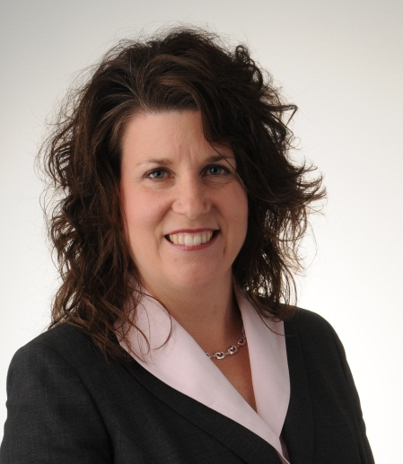
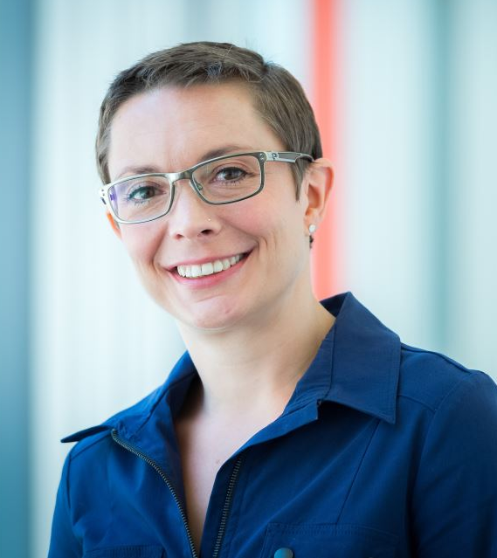
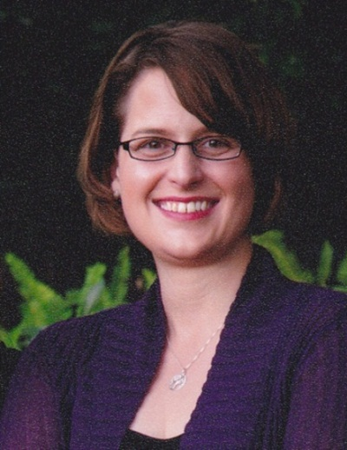
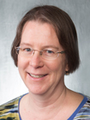
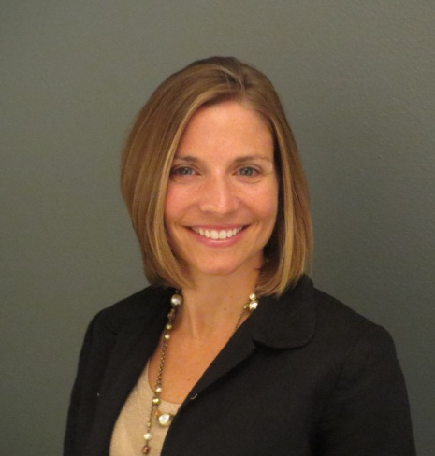
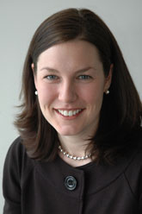
Joy
Jehannine
Sandra
Laura
Jen
Meghan

Slide 6
2015 Board of Directors
Directors At Large
Carrie Blout, MS, CGC
Erica Ramos, MS, CGC
Kaylene Ready, MS, CGC
Dan Riconda, MS, CGC
Sara Riordan, MS, CGC
Leigha Senter, MS, CGC
Quinn Stein, MS, CGC

Slide 7
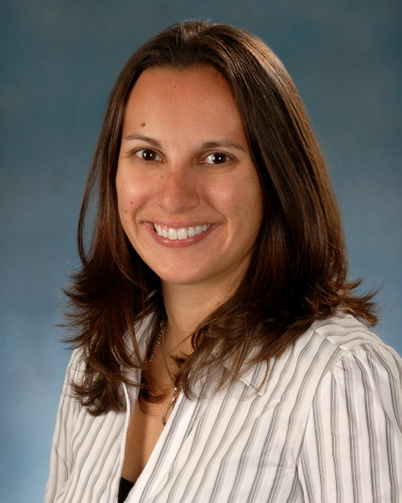
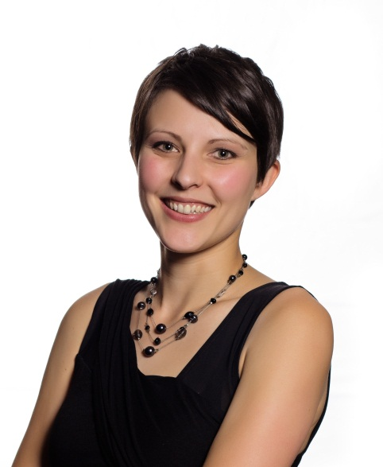
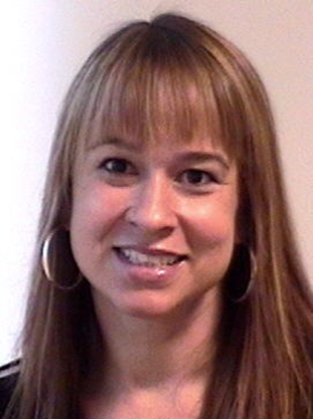
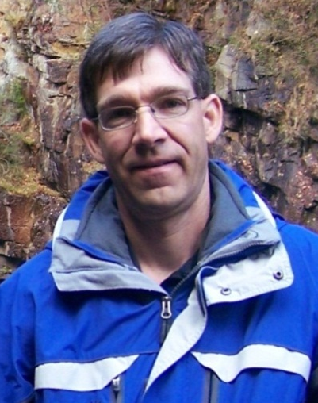
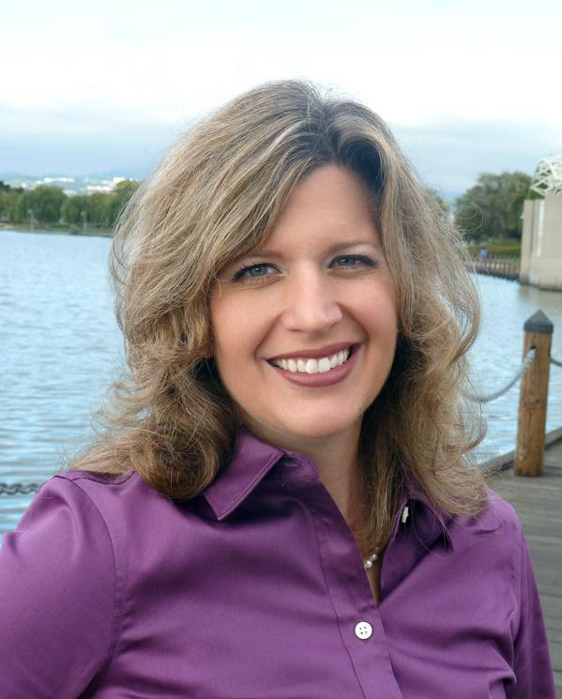
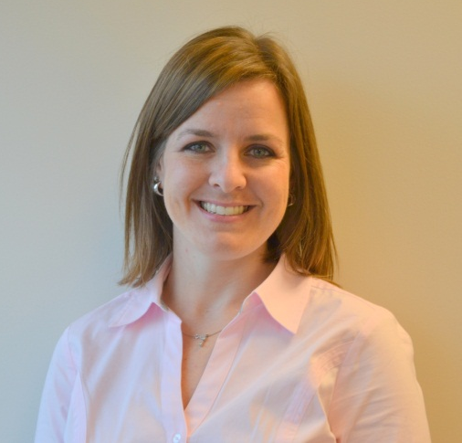
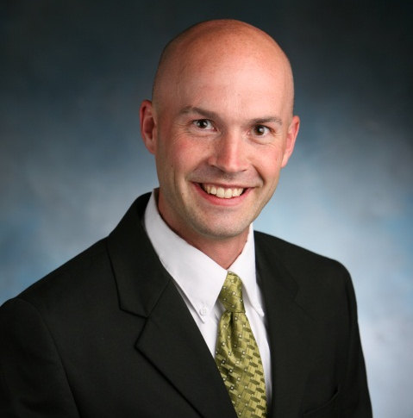
Carrie
Erica
Kaylene
Dan
Sara
Leigha
Quinn
Notes:
Thank you to Brenda and Karen who are rolling off

Slide 8
Welcome New Members of the
2016 NSGC Board of Directors!
President-Elect: Mary Freivogel, MS, CGC
Secretary-Treasurer Elect: Monica Marvin, MS, CGC
Director At Large: MaryAnn Campion, MS, CGC
Director At Large: Katie Dunn, MS, LCGC
Director At Large: Erynn Gordon, MS, CGC

Slide 9

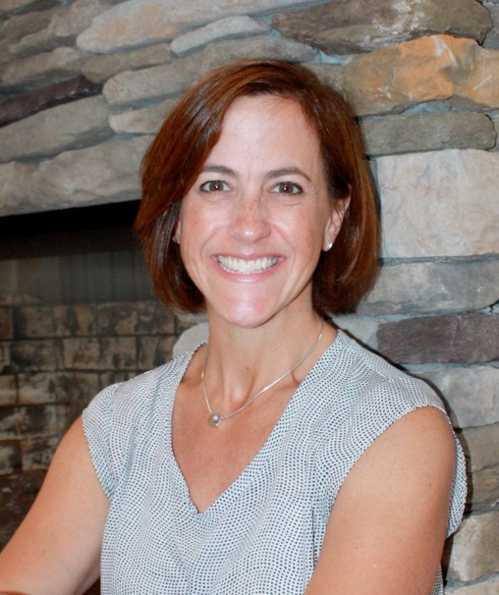
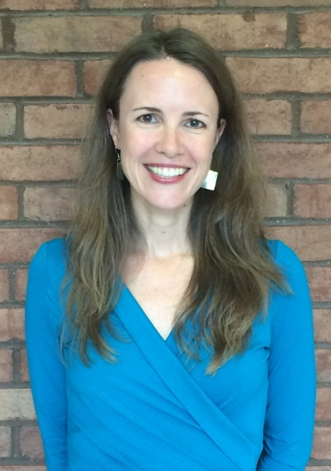
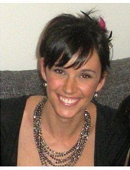
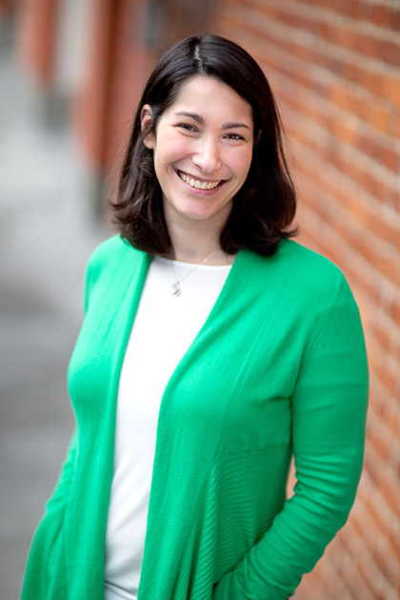
Mary
Monica
MaryAnn
Katie
Erynn

Slide 10
2015 Committee Chairs and Vice Chairs
Access and Service Delivery Committee
Kate Wilson, Chair
Colleen Campbell, Vice Chair
Education Committee
Heather MacLeod, Chair
Emily Edelman, Vice Chair
Marketing & Communications Workgroup
Melissa Stosic, Chair
Membership Committee
Holly Zimmerman, Chair
Shar Munshi, Vice Chair
Public Policy Committee
Shanna Gustafson, Chair
Andy Faucett, Vice Chair
Practice Guidelines Committee
Deepti Babu, Chair
Gillian Hooker, Vice Chair

Slide 11
2015 Special Interest Group (SIG) Chairs
ART/Infertility | Lauren Isley | Andria Besser
Cardiovascular Genetics | Sara Cherny | Brittney Murray
Cystic Fibrosis | Karen Raraigh | Barbara Karczeski
Education | Shraddha Gaonkar | Kate Shane-Carson
Familial Cancer Risk | Sara Pirzadeh-Miller | Victoria Raymond
Genetic Technologies | Kim Banks | Kelly Farwell Hagman
Health IT | Heather Fecteau | Megan Doerr
Industry | Lily Servais | Darci Sternen
International | Rawan Awwad | Jennifer Fitzpatrick
Metabolism/LSD | Amy White | Lauren McNair Baggett | Katharine Stoate
Neurogenetics | Shawna Feely | Jennifer Roggenbuck
Pediatric | Kimberly Lewis | Rebecca Okashah
Personalized Medicine | Sarah Kalia | Megan Grove
Prenatal | Shannon Wieloch | Blair Stevens
Psychiatric Disorders | Carmela Thompson | Hannah White
Public Health | Amy Gaviglio | Kate Reed
Research | Sharon Aufox | Gillian Hooker
Student / New GC | Elysia Davis | Monica Helm

Slide 12
Thank you to all of NSGC’s dedicated volunteers
We could not do it without you!
  Committees
  Task Forces
  SIGs
  Workgroups
  Subcommittees
  Ethics Advisory Group
  AEC/Abstracts
  JEMF
  AHSPA
  Rollnick
  Liaisons
  Journal of Genetic Counseling
  Perspectives
  Various projects
  Many individual contributors!

Slide 13
NSGC Strategic Initiatives
Joy Larsen Haidle, MS, CGC
NSGC President
Notes:
13

Slide 14
Rolling Strategic Plan
Differs from traditional strategic planning
  Annual review of landscape by Board and plan adjustments and edits to ensure we are proactive and relevant
  Full review of strategic initiatives every 3 years
  Align each 3-year strategic plan to support longer-term goals
  We need member support for this process – you are our best resource
    Engage with committees, subcommittees and workgroups
    Participate in SIGs
    Contact your leaders with emerging information

Slide 15
From Strategy to Action
Strategic Plan
Annual Plan of Work
Committee Charges
Action
NSGC’s volunteer Committees, SIGs and Task Forces are the power behind achieving our strategic goals

Slide 16
NSGC’s 2015 - 2017 Strategic Objectives
Access
Growth
Value
Payer recognition of GCs
  Ensure quality
  Cost effective
Reimbursement
Licensure
Coalition-building
Promoting value to
other providers
Standard-maker
Workforce growth
Efficient, effective practice
Varied and expanding roles
Specialization
Technology to support efficiency
Collaboration with ABGC, ACGC & AGCPD
Consumer focus
NSGC as a provider of genetic information
Member Value
Education
Professional development
Support for changing landscape

Slide 17
2015 Public Relations
Joy Larsen Haidle, MS, CGC
NSGC President
Notes:
17

Slide 18
Results by the Numbers
This year to date, we secured 32 original placements and eight via pick-up. Our media efforts resulted in the following:
40
77.6 MM
Total number of media placements
Audience reach of placements
      © Public Communications Inc. 2015

Slide 19
Coverage by Topic
      NSGC coverage topics have included articles about prenatal testing, precision medicine, oncology and DTC testing.
      © Public Communications Inc. 2015

Slide 20


Social Media
In addition to our media placements and reach, our social media channels have a combined audience of 5,599 members, media and consumers, a 31 percent increase from the end of 2014, and year-over-year increase of 59 percent.
      © Public Communications Inc. 2015

Slide 21
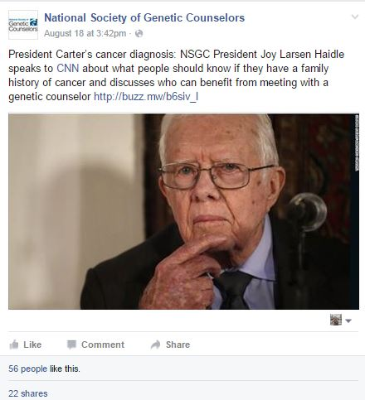

Social Media
2,875
Total number of Twitter followers by Aug. 31, 2015
2,724
Total number of Facebook likes by Aug.31, 2015
      © Public Communications Inc. 2015

Slide 22
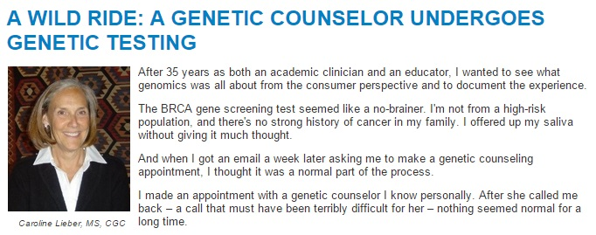
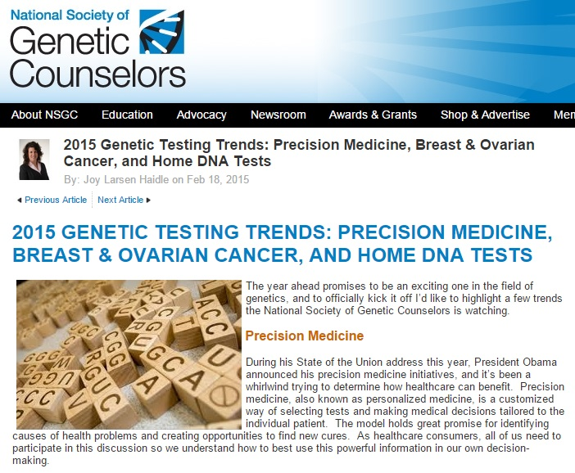
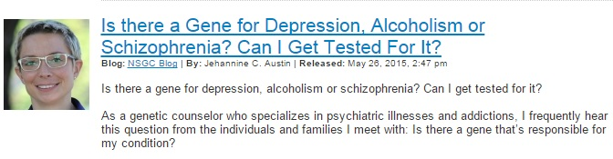

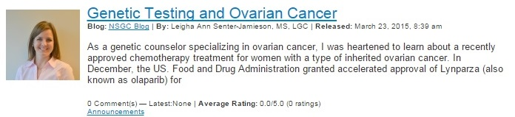
NSGC Blog
        In 2015, we have published 10 blog posts written by our Expert Media Panel and other NSGC members to provide genetic counseling information to consumers.
      © Public Communications Inc. 2015

Slide 23
NSGC Leadership Development
Joy Larsen Haidle, MS, CGC
NSGC President
Notes:
23

Slide 24
Developing NSGC leaders
During 2015, NSGC implemented the first phase of dedicated leadership development programming.
First round primarily focused on incoming Committee Vice Chairs, limited programming for incoming Board members
  Committee focus reflects the key role of our committees in achieving our strategic initiatives
  Vice Chairs, over their terms with the committees, will touch a great number of committee members and share the leadership concepts learned in the program

Slide 25
Volunteer Leadership Program
Intent is to start with this program, to impact leadership within NSGC, and then determine how we can expand programming to other groups within the membership
Current program focuses on leadership as enabling outcomes by leading and inspiring others
We have continued to incorporate leadership concepts in our other education, programming and society activities to generate a culture of leadership throughout the society
Notes:
Example: training on how to build a case and talk to payers included in the Business Foundations course incorporates many different leadership skills

Slide 26
Leadership support from our management partner
Our relationship with SmithBucklin provides many resources to support our Society, Board, and volunteer leaders
  Leading practices from 100+ professional associations, including 29 healthcare associations
  Annual Leaders Forum attended by two Board members
  Annual strategic planning facilitation, Board governance and leadership training by SmithBucklin consultants - all experienced executive directors of professional associations

Slide 27

NSGC a leader among associations – again!
PCI and NSGC won a Silver Trumpet Award from the Publicity Club of Chicago the launch and impact of the educational NSGC Blog which features consumer-focused posts written by NSGC’s Expert Media Panel and other genetic counselors.
NSGC recognized again this year by the Trade Show News Network as one of the top 25 tradeshows in net square foot growth from 2012 to 2014
Notes:
NSGC has been exposed best practices is association management from the literature, and continues to strive for and adopt leading practices in areas such as governance, board function, nominations and elections.

Slide 28
2015 Nominations and Election Process & Results
Joy Larsen Haidle, MS, CGC
NSGC President
Notes:
28

Slide 29
NSGC Leadership: Nominations and Elections
Nominating Committee:
Committee made up of president, past president, 2 non-officer board members and 3 at-large members
Three at-large members selected by Membership Committee from individuals responding to an open call for applicants

Slide 30
NSGC Leadership: Nominations and elections
Call for Nominations opened in January 2015:
  Members submitted 60 nominations
    Nominations represented 22 individuals; 21 were willing to be considered
  Nominees assessed using a combination of quantitative and qualitative measures
    Quantitative measures provide overall metrics for candidates
    Qualitative measures provide assessment of skills, years of experience, fit with current board, interview, and specialty area and work setting

Slide 31
Data from 2015 nomination/election cycle
WORKPLACE | NOMINEES | SLATED | 2016 BOD
University medical center | 8 | 2 | 4^
Private/public/government hospital or facility | 6 | 2 | 5
Industry/Lab | 7 | 1 | 3
Other | 0 | 0 | 0
Totals | 21 | 5 | 12
^ includes at least one GC training associate/assistant program director

Slide 32
Data from 2015 nominations/election
SPECIALTY | NOMINEES | SLATED | 2016 BOD
Cancer | 5 | 2 | 4
Pediatric | 4 |  | 1
Prenatal | 6 | 1 | 2
Personalized medicine/WGS | 2 | 1 | 2
Other | 4 | 1 | 3
Totals | 21 | 5 | 12
Notes:
MaryAnn/dan- prenatal
peds/- carrie
Erynn Gordon/sara riordan- personalized medicine
joy/kaylene/marvin/freivogel- cancer
Jehannine/laura/dunn- other

Slide 33
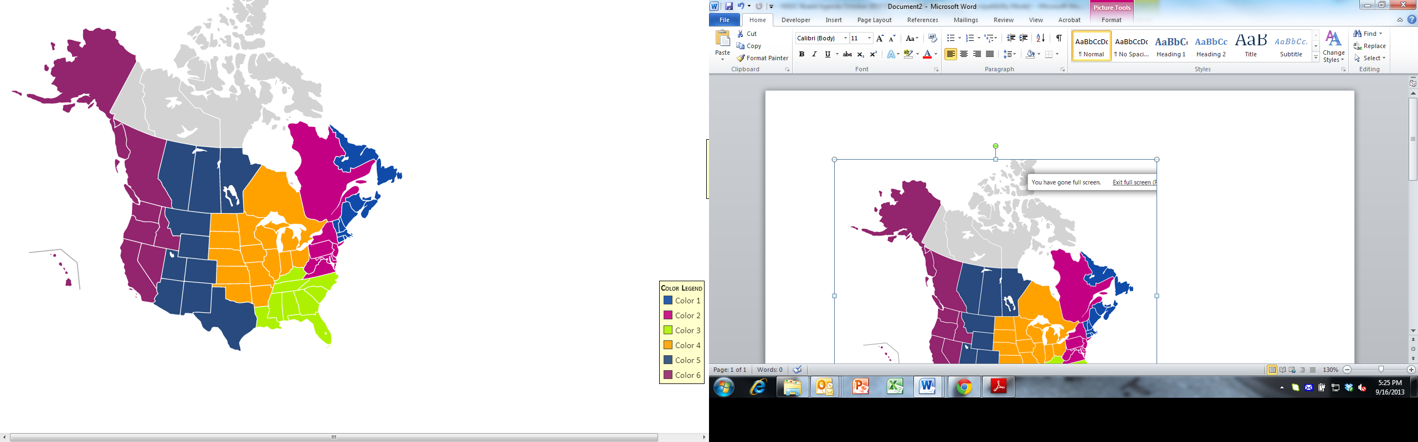
REGION | NOMINEES | SLATED | 2016 BOD
1 | 1 | 1 | 2
2 | 2 | 1 | 2
3 | 0 | 0 | 1
4 | 8 | 1 | 2
5 | 5 | 2 | 4
6 | 5 | 0 | 1
5
1
2
6
3
4
Notes:
Previous years we’ve been light in 4 and heavy
in 1, 2 and 6
And people move jobs during board term much more than in previous years.

Slide 34
NSGC Leadership: Nominations and Elections
Election Results:
Membership identified strong pool of nominees
Diverse slate presented (specialization, work setting, years of experience, gender)
36% of eligible voters participated
Ballot approved by 95% of those voting
  5% abstained from voting
  1% submitted write-ins and/or did not approve the slate

Slide 35
Nominations: Future directions
Continue to enhance feedback process to nominees
Call for nominees opens in early 2016
You can make a difference in the future of NSGC:
  Nominate a colleague
  Apply to serve on the Nominating Committee
  Nominate yourself!
Notes:
Add in anything that may need to be updated based on Board discussion

Slide 36
2014 - 2015 Financial Report
Sandra Darilek, MS, CGC
NSGC Secretary/Treasurer
Notes:
36

Slide 37


Financial Objectives in 2014
Fully funding operations through our operating revenue
Investing in our members and the profession
Investing in tools and initiatives to help our members and association succeed
  Increased advocacy support
  Increased public relations support
  Development of new educational products
  Funding for workforce initiatives
Notes:
37

Slide 38

NSGC Membership: 3,174 and Growing!

Slide 39
Cash Assets as of December 31, 2014
Cash Assets
  NSGC liquid assets: $1,704,187
  NSGC Investments $1,386,375
  JEMF: $42,903
  Rollnick: $72,431
  AHSPA $20,139
Budgeted Revenue: $2,321,510
Year-end Actual Revenue: $2,741,025
Budgeted Expenses: $2,434,714
Year-end Actual Expenses: $2,321,333
2014 Budgeted Net Revenue: ($113,204)
2014 Year-end Actual Net Revenue: $419,691
Notes:
39

Slide 40
Sources of Revenue: 2014 Year-end

Slide 41
Expense Distribution: 2014 Year-end
*Note that general administration includes staff, legal fees, IT, website hosting, public relations, accounting, insurance, bank and credit card fees, office services and postage.

Slide 42
NSGC Continues to Grow and Invest…

Slide 43
Progress toward financial goals
Ended 2014 with an overall surplus of $218,556 after incorporating our restricted funds and any gains/losses from investments.
Funded both operations and strategic initiatives through operating revenue, allowing us to preserve and grow our reserves
Allowed us to make some significant strategic investments in 2014 in PR, Advocacy and our new Leadership Development Program
We have not accessed our investment funds to cover any expenses since 2006
Notes:
43

Slide 44
Where do we stand today?
2015 Forecast
  Budgeted Revenue: $2,500,180
  9+3 Forecast for Revenue: $2,800,939
  Budgeted Expenses: $2,511,976
  9+3 Forecast for Expenses: $2,646,276
2015 Budgeted Net Revenue: ($11,796)
2015 9+3 Forecast for Net Revenue: $154,663
Notes:
44

Slide 45
NSGC Publications Update
  Journal of Genetic Counseling
  Perspectives in Genetic Counseling
Joy Larsen Haidle, MS, CGC
NSGC President

Slide 46
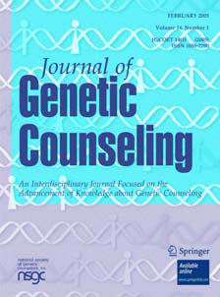
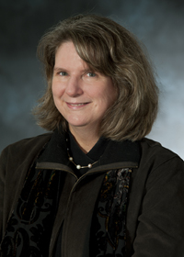
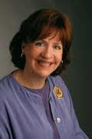
Journal of Genetic Counseling
Bonnie LeRoy, MS, CGC
Editor-in-Chief
    Pat McCarthy Veach, PhD
    Assistant Editor
Notes:
46
Bonnie request:
“Pat wanted to have her picture touched up so she looks like Angelina Jolie. If you have that technology available to you, I would like to look like Sandra Bullock. We would appreciate the help.”
46

Slide 47

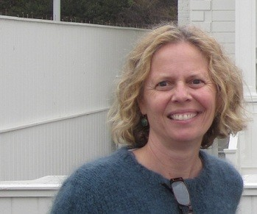

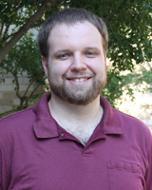
Journal of Genetic Counseling
Associate Editors
Christina Palmer, PhD
Editor for COI papers
    Ian MacFarlane, PhD
    Stats expert extraordinaire!
Notes:
47
47

Slide 48
Journal of Genetic Counseling data
September 30, 2014 through October 1, 2015
Manuscript submission and processing has increased
  Over the past 12 months, JOGC editorial office received:
    236 new submissions; 19-20 new per month
    278 manuscripts were sent out for revision
    257 revised manuscripts were received
  Average # of days from submission to first decision is 48 (time to publication varies dependent upon time taken to revise)
  Total number of reviewers invited was 785!!
  The rejection rate for original submissions is 41%
We had about 6.5% increase in the number of new manuscripts received over the same time period last year.
Author satisfaction: 94% said would likely publish again.
Notes:
48
48

Slide 49
Additional Journal of Genetic Counseling highlights
The Impact Factor has increased to 2.343!!
The abstracts from this meeting will be in the Dec 2015 issue
A Special Issue on Public Heath Genetics and Genomics guest edited by Amy Gaviglio and Kirsty McWalter was published in June of 2015.
A Special Issue on Genetic Counselor Professional Development is in the final stages of preparation. This issue is guest edited by Nancy Callanan and Krista Redlinger-Grosse.
Springer has provided funding to the NSGC that will allow the Editorial Board to recognize outstanding student publications in the JoGC. Up to 2 papers annually will each receive a $500 award. The editorial board is developing a selection process for these awards.
Notes:
49
49

Slide 50
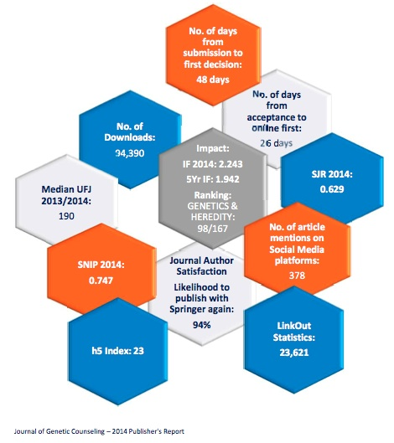
Journal of Genetic Counseling
A call for papers is out for a Special Issue: Working with Psychological and Social Complexity.
If you have an appropriate manuscript, please participate in this issue.
(See website for JoGC for full description of call for papers).
If you are interested in serving as a reviewer, PLEASE contact Bonnie or Pat. Your expertise is important!
leroy001@umn.edu
veach001@umn.edu

Slide 51
Perspectives in Genetic Counseling
Kirsty McWalter, MS, CGC, Editor
Kristen Hanson, MS, CGC, Associate Editor

Slide 52
Perspectives in Genetic Counseling
Perspectives continues to be a highly valued member benefit
Online format has been very well-received.
Content solicitation strategy:
  Maintains pipeline of thoughtful and interesting articles
  Highlights a range of genetic counselor experiences
New next year: PGC will introduce a "Diversity" column
  Will alternate with the popular Global Genetics column.
We welcome contributions and suggestions from NSGC members!

Slide 53
Perspectives in Genetic Counseling Readership Data
Open rates continue to be strong and average 43% with click-through rates around 38%
In comparison, open rates for associations and healthcare organizations are 11-30% and click-through rates are 6-8% (Constant Contact FAQs, August 2015)
 | Total Distribution | Opens | Open Rate | Click Throughs | Click Through Rate
Q1 2015 | 3220 | 1152 | 40% | 374 | 33%
Q2 2015 | 2883 | 1098 | 40% | 338 | 31%
Q3 2015 | 3029 | 1148 | 39% | 421 | 37%

Slide 54
Perspectives in Genetic Counseling
The Perspectives Committee continues to be a very dedicated group of volunteers – we thank them for their work!

Slide 55
Question & Answer Session
Joy Larsen Haidle, MS, CGC
2015 President
Jehannine Austin, PhD, MS, CGC/CCGC
2015 NSGC President Elect
Sandra Darilek, MS, CGC
2015 Secretary/Treasurer
Meghan Carey
Executive Director

Slide 56
Leading Voices Drawing Winners – Congratulations!
We had 222 leading voices nominations
submitted this year!
Deepti Babu
Janice Berliner
Katie Stoll
Tanya Bardakjian
Joyce Turner
Amy Gaviglio
Amy Poole
Flora Poleshchuk
Sara Gilvary
Diana Tully

Slide 57

Thank you for your participation!

